Slide 1
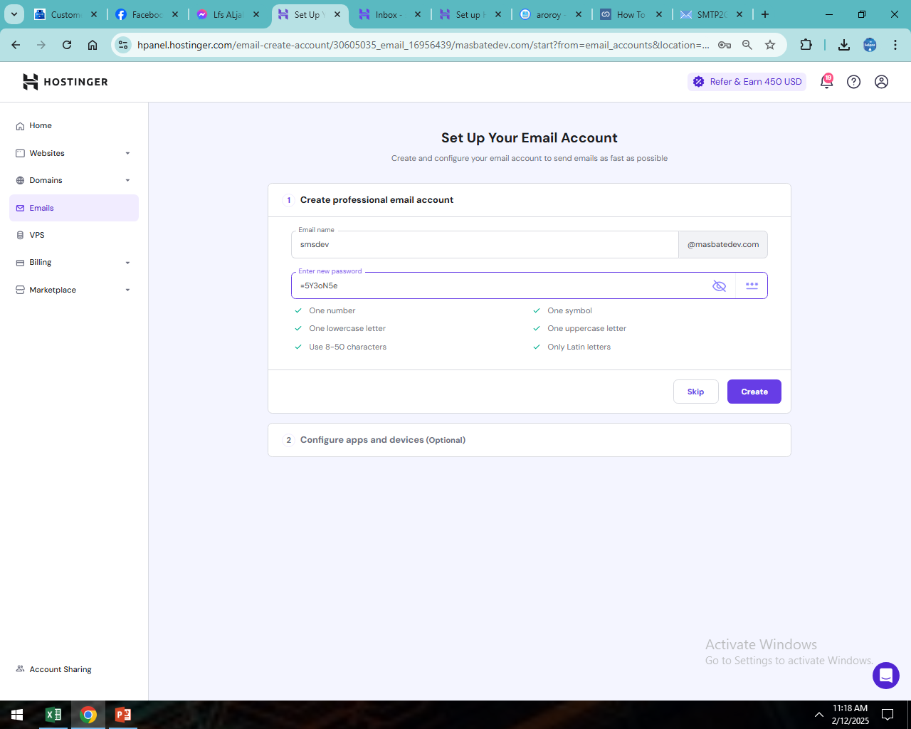

Slide 2
debesmscatJOMZ012597@@
api-576F86DAF5BC4067A4B7DECF7A1F913A

Slide 3
